Slide 1
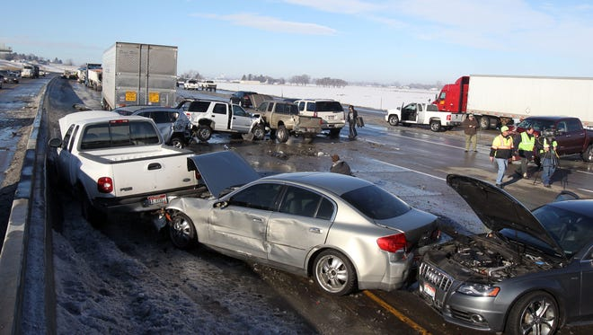
Predicting Injury Severity in Accidents
Rohith Kotar
Under the guidance of Professor Dr. Chaojie (Jay) Wang

Slide 2
Introduction
Project aims to develop a robust predictive modeling approach for estimating injury severity in accidents for an unbalanced dataset.
Improved injury severity prediction can aid in the development of proactive measures for accident prevention, contributing to overall public safety and reducing the occurrence of severe accidents.
Reliable injury severity prediction models can facilitate the development of personalized treatment plans for accident victims, optimizing healthcare resources and improving patient outcomes.

Slide 3
About the Data
Dataset Link: https://data.montgomerycountymd.gov/Public-Safety/Crash-Reporting-Drivers-Data/mmzv-x632
Shape – 172105 rows X 51columns
File Size – 104MB.

Slide 4
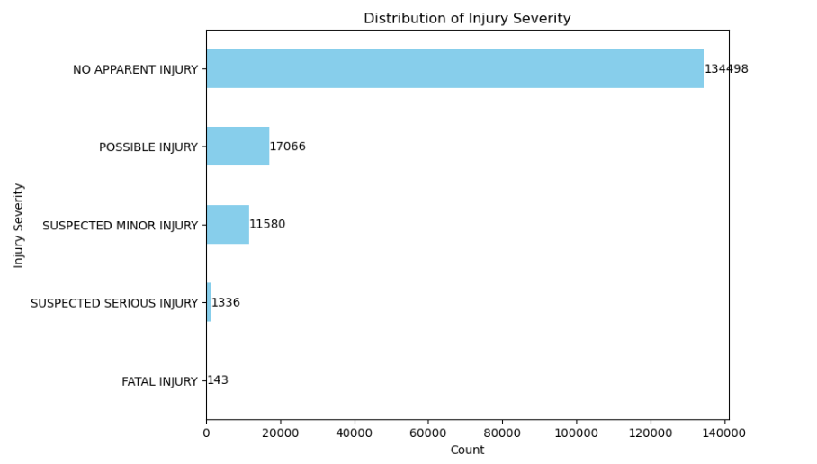
Target Variable Distribution:

Slide 5
Data Preprocessing Pipeline
1. Column Selection:
- Identified and dropped columns that were deemed unnecessary for predicting the target variable.
- Conducted careful analysis to ensure that only relevant features were retained.
- Removed redundant or highly correlated features to prevent multicollinearity issues in the predictive model.
2. Outlier Removal:
- Employed the Z-Score method to detect outliers in the dataset based on their standard deviations from the mean.
- Set a threshold Z-Score value (e.g., Z > 3 or Z < -3) to identify extreme values that deviate significantly from the mean.
- Removed outliers from the dataset to prevent them from disproportionately influencing the model's performance.
- Carefully validated outlier removal to ensure that genuine data points were not erroneously discarded.
3. Feature Engineering:
- Conducted feature extraction to derive new features from existing ones, aiming to capture additional information and improve model performance.
- Applied transformations to make the data more suitable for modeling.
- Utilized domain knowledge and exploratory data analysis (EDA) to engineer features that capture relevant patterns or relationships in the data.
- Ensured that feature engineering techniques were applied judiciously to avoid overfitting and maintain model interpretability.

Slide 6
Data Preprocessing Pipeline
4. Encoding:
-Implemented One-Hot Encoding for categorical features, converting them into binary vectors to represent each category as a separate feature.
-Utilized Ordinal Encoding for categorical features where the order is meaningful, preserving the inherent ordinal relationships between categories.
5. Scaling:
- Applied StandardScaler to scale the features to a standard normal distribution with a mean of 0 and a standard deviation of 1.
- Standardized the features to ensure they have comparable scales and prevent features with larger magnitudes from dominating the model.
6. Feature Selection :
- Evaluated the performance of the model with different subsets of features to identify the optimal feature set that balances predictive accuracy and model simplicity.
- Conducted feature importance analysis to prioritize features that have the most significant impact on the target variable, thereby reducing dimensionality while preserving predictive power.
- Employed techniques such as cross-validation to ensure that feature selection decisions generalize well to unseen data and mitigate the risk of overfitting.
In Streamlit application, scikit-learn pipeline is used to facilitate seamless data processing. With user inputs as the initial step, the pipeline orchestrates the preprocessing steps, including ordinal encoding, one-hot encoding, and standard scaling, which were performed during model training. This approach ensures consistency and efficiency in data preparation, allowing the model to seamlessly handle user-provided inputs and deliver accurate predictions.

Slide 7
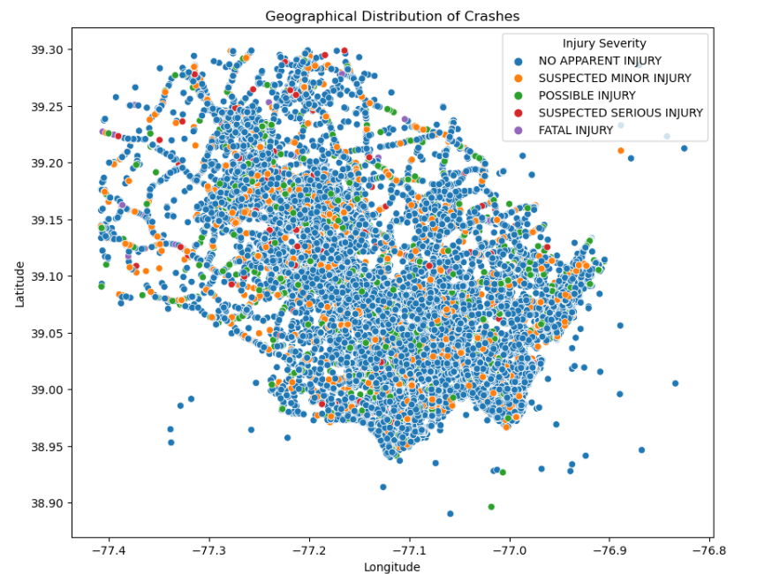
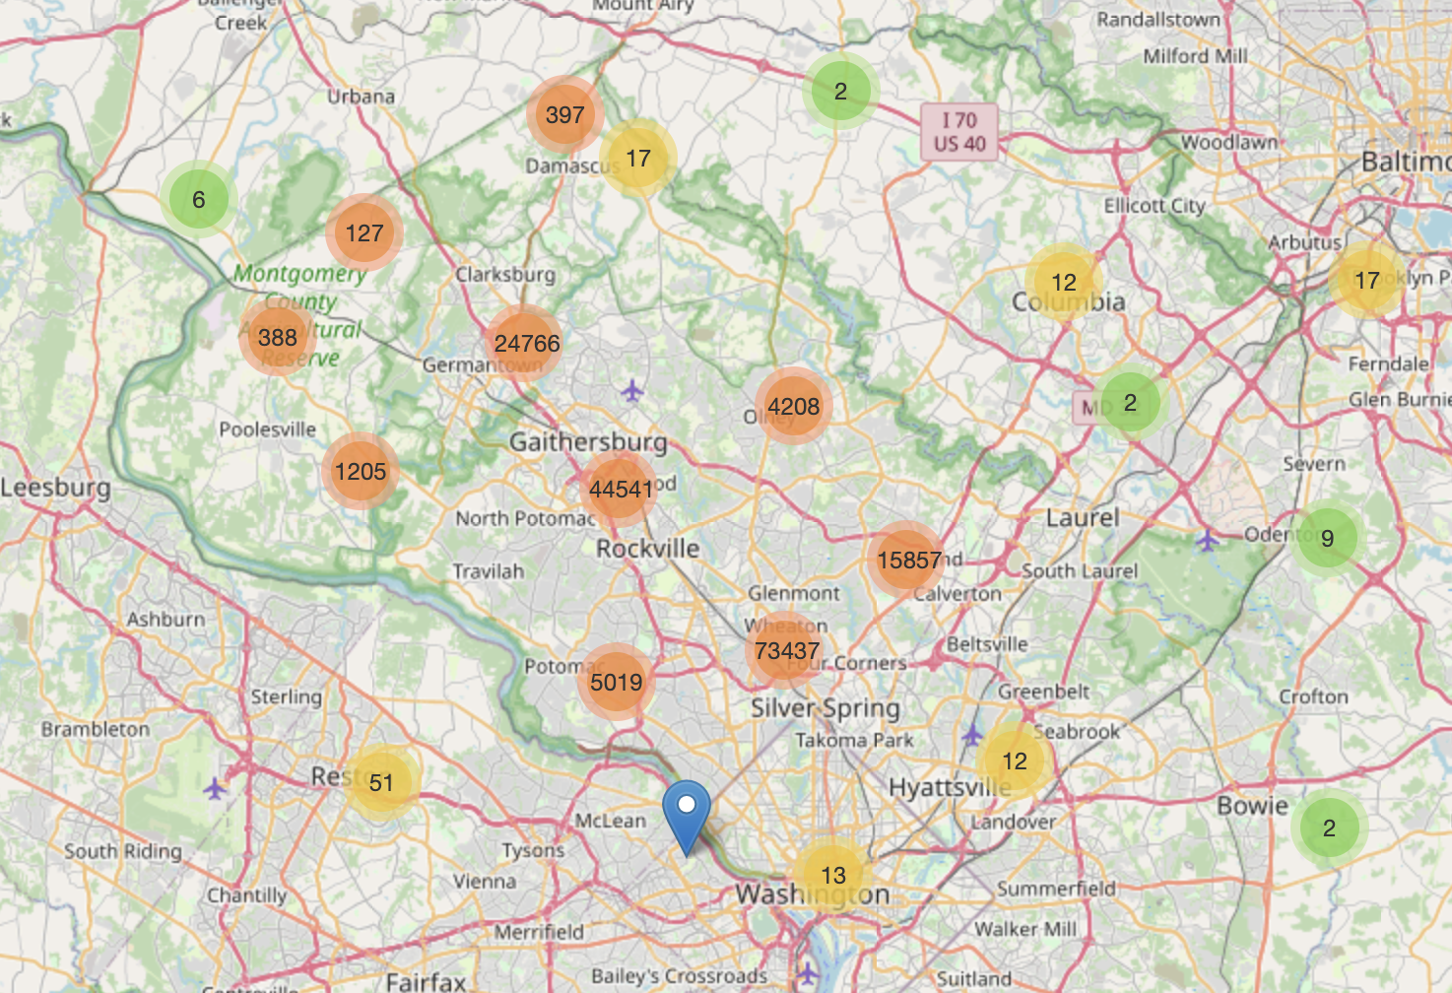
Geographic Distribution of Crashes

Slide 8
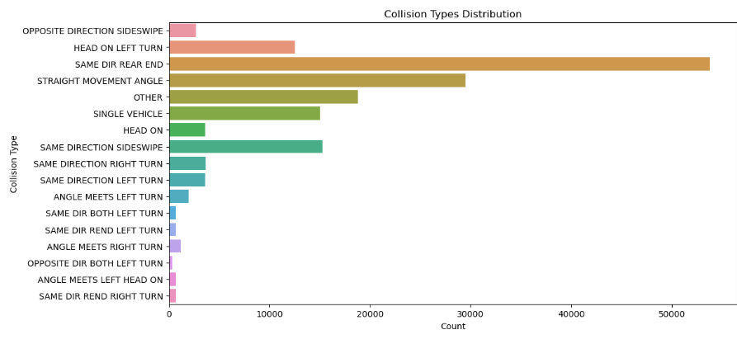
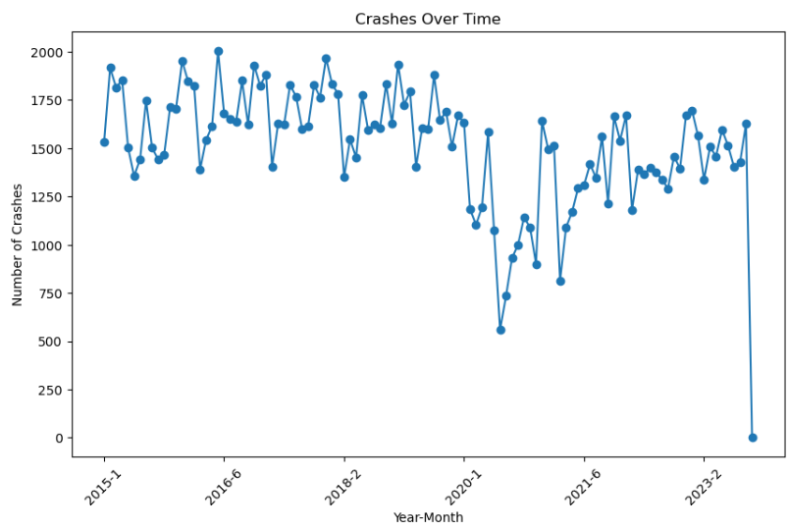
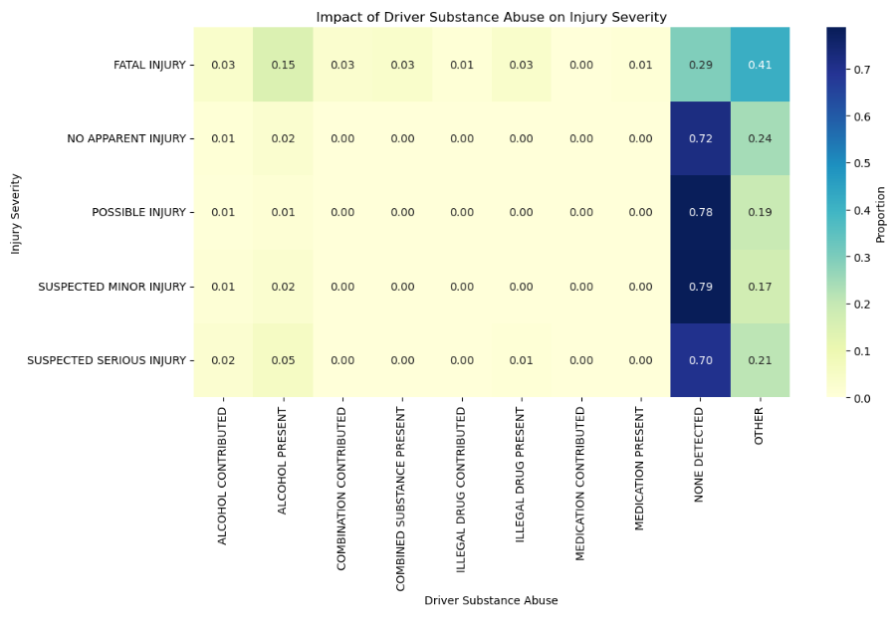

Slide 9
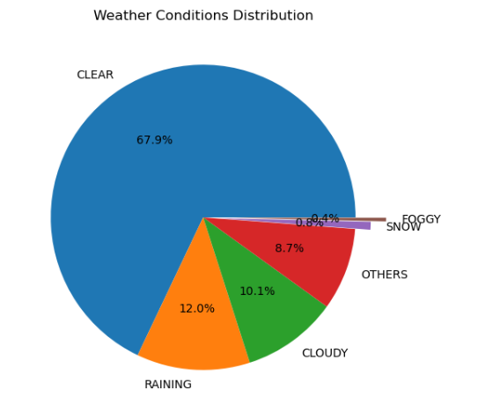
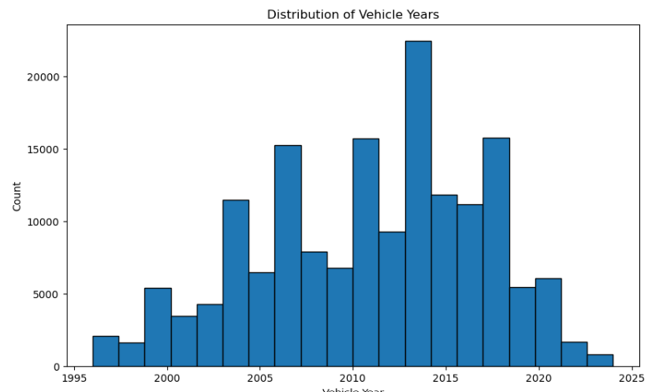

Slide 10
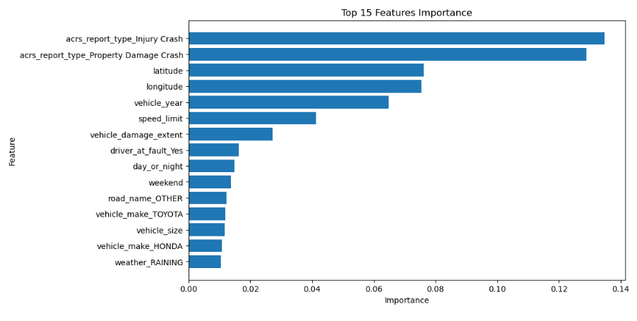
Feature Importance

Slide 11
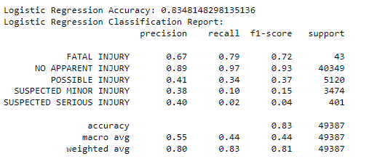
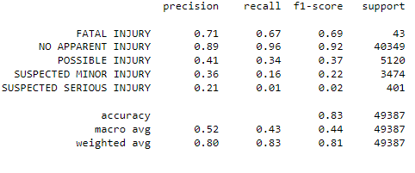
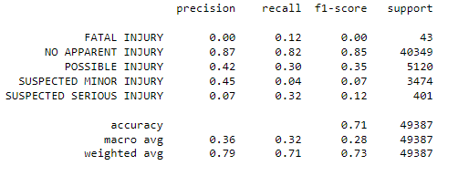
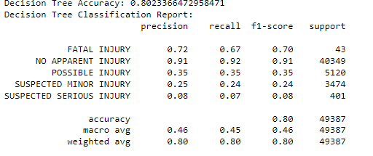
Logistic Regression
Random Forest
Gradient Boosting
Decision Tree

Slide 12
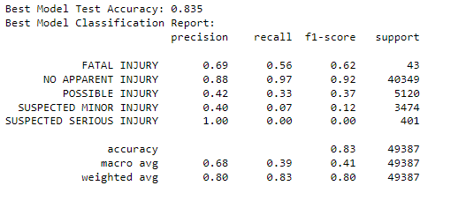
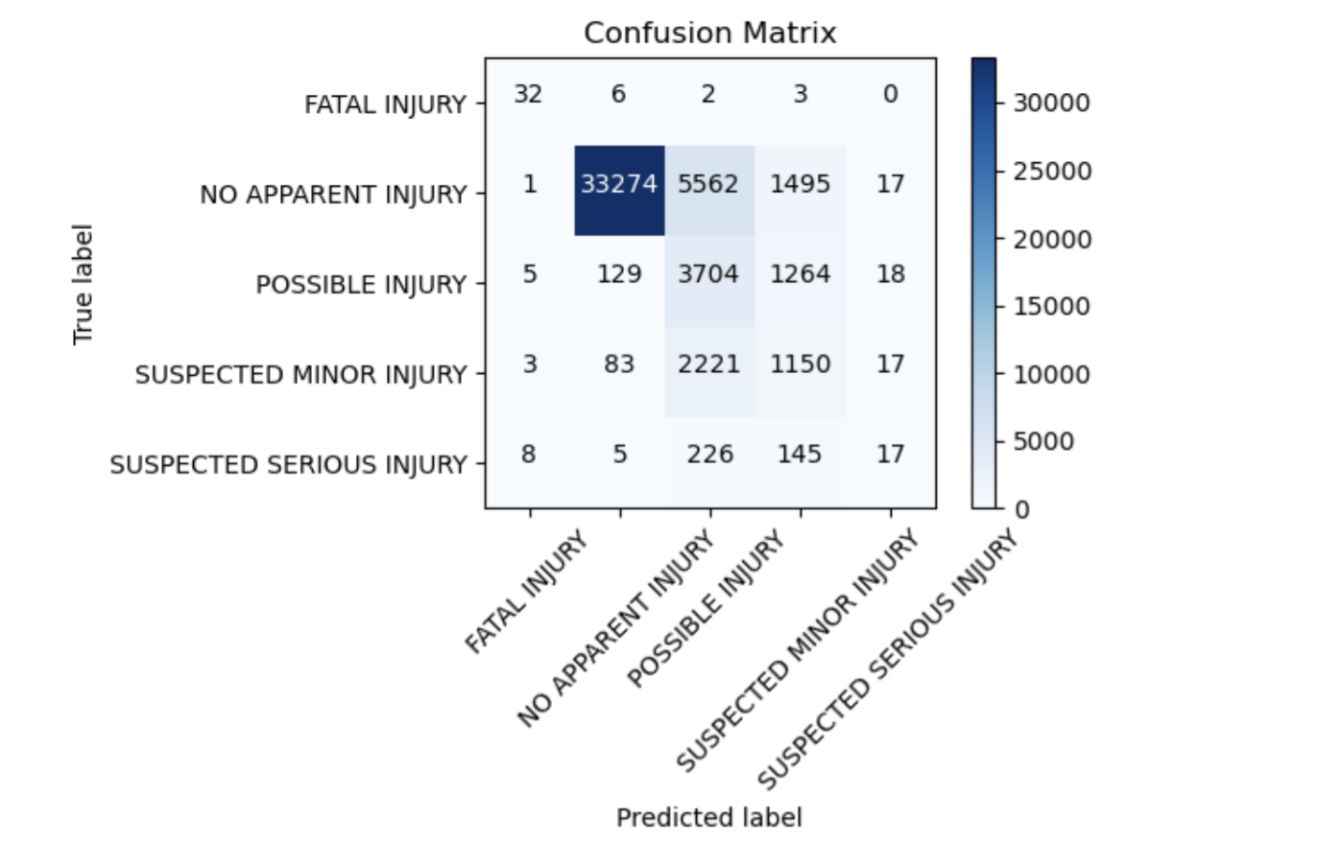
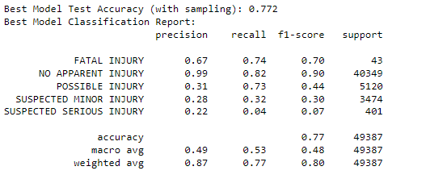
RANDOM FOREST WITH GRIDSEARCHCV
SMOTENN

Slide 13

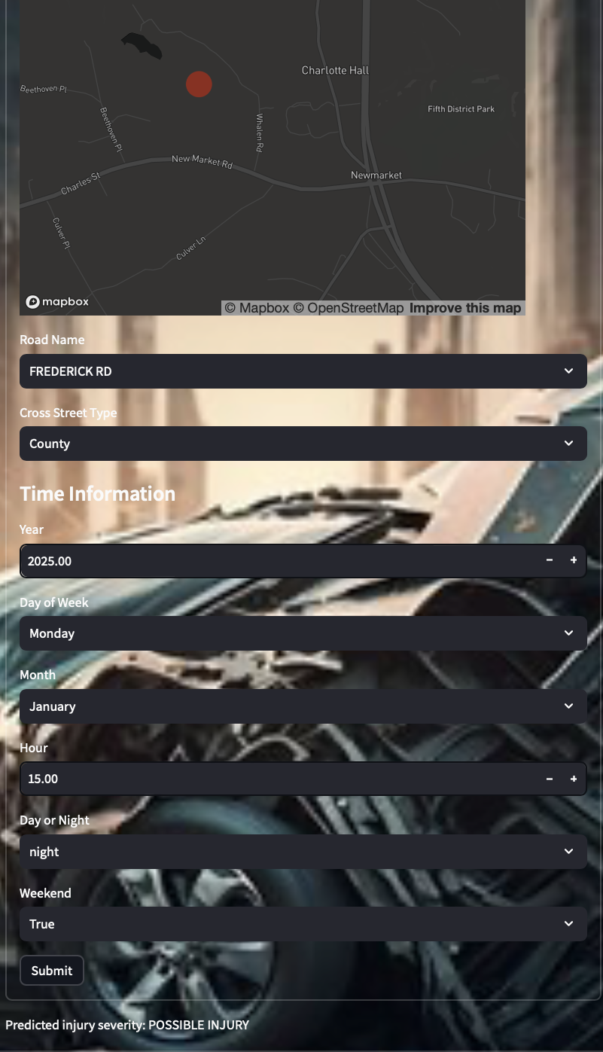

Slide 14
References
Feature Engineering for Machine Learning: Strategies for Data Preprocessing by Kuhn, M., and Johnson, K. (2019)
"Injury Severity Prediction: A Review of Literature and Methods" by Abdel-Wahab, O. M., et al. (2009). This paper provides a comprehensive overview of injury severity prediction methods.
XGBoost: A Scalable Tree Boosting System https://arxiv.org/abs/1603.02754
Feature Engineering - https://youtu.be/sluoVhT0ehg

